Slide 1




Practical Data Anonymisation
in ​Circadian and Mental Health Research​
BioRDM (Biological Research Data Management​)
Prof Andrew Millar
School of Biological Sciences, University of Edinburgh
Livia Scorza ----- Data team leader​
Haya Deeb ------ Research Data Assistant​
Daniel Thedie --- Research Software Specialist​
Workshop 5th June 2025

Slide 2
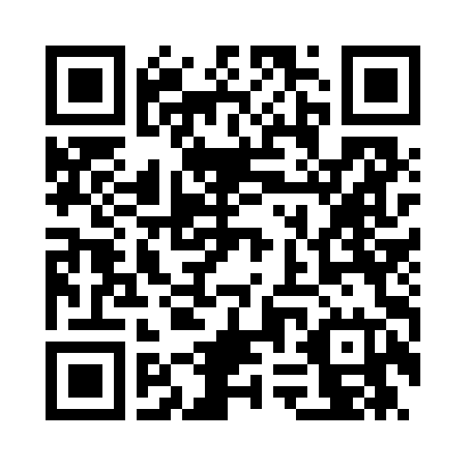

Welcome
House Keeping
Toilets
Fire alarms; no expected fire alarm during the workshop
Questions are welcome at anytime
Wooclap code
10 min coffee break
Go to Wooclap.com
Code CMHN

Slide 3


Workshop Overview
Obligations and Regulations
Making Data Available
Personal Data
Direct and Indirect Identifiers
De-identification VS Anonymisation
Anonymisation Techniques
Pseudonymisation VS Anonymisation
Anonymisation Tools
Hands-on Exercise
Final considerations

Slide 4

Your obligations​
Legal obligations:​
- Comply with data protection legislation​
Protect individual’s rights
EU General Data Protection Regulation (GDPR)​
In the UK: UK GDPR and the Data Protection Act 2018​
Be familiar with data protection regulation and ethics
Ethical obligations:​
How the data is used. ​
E.g.: ​
- Obtain informed consent from patients/ participants. ​
- Provide information about data collection, use and archiving.​
- UK Data Ethics Framework

Slide 5

Data Sharing
Why do we need to share our data?
- Compliance with funders/ publishers/ institutional policies​
UKRI- MRC​
“Data must be made available with as few restrictions as possible, to maximise the value of the data, improve research reproducibility and for patient and public benefit”. ​
​“ As open as possible, as closed as necessary”​
​​- Benefits: collaboration, transparency, reproducibility, increased impact.
But sharing personal/sensitive data requires appropriate safeguards…​

Slide 6

History Cases
Email Mishap at HIV Clinic (2015)
Hard Drives Sold on eBay (2010)
London’s 56 Dean Street clinic accidentally exposed the emails of 781 patients by using ‘To’ instead of ‘Bcc’. The mistake revealed attendees of an HIV clinic and led to a £180,000 fine and major privacy concerns.
Brighton and Sussex NHS Trust was fined £325,000 after 252 hard drives with sensitive patient data were sold online. A contractor failed to destroy the drives, exposing thousands of records.
Would you classify these incidents as data management errors or anonymisation failures?
Case 1 2015 - Case 2 2010

Slide 7
History Cases
Netflix Prize Re-identification (2006)
Myki Travel Data Leak (2018)
Netflix released an anonymised movie rating dataset for a $1M contest. Researchers cross-referenced it with IMDb and re-identified users, proving that anonymisation was insufficient.
The Victorian government released anonymised public transport data for research. Researchers re-identified individuals by analysing travel patterns — even identifying themselves — exposing risks in granular data sharing.
Would you classify these incidents as data management errors or anonymisation failures?
Case 3 2006 - Case 4 2018

Slide 8
Data Anonymisation
Why?
The complete and irreversible removal of any information that could lead to an individual being identified, either from the removed information itself or this information combined with other data.
Privacy protection and research ethics
Legal compliance (GDPR)
Data sharing (internal & external)
Public trust (transparency)
Reduce costs
Definition by UoE
An effective anonymisation reduces the likelihood of someone being identified or identifiable to a sufficiently remote level.​

Slide 9
Personal Data
By UK GDPR
“personal data’ means any information relating to an identified or identifiable natural person (‘data subject’);​
an identifiable natural person is one who can be identified, directly or indirectly, in particular by reference to an identifier such as a name, an identification number, location data, an online identifier or to one or more factors specific to the physical, physiological, genetic, mental, economic, cultural or social identity of that natural person”.​
https://ico.org.uk/for-organisations/uk-gdpr-guidance-and-resources/​

Slide 10


Personal Data
By UK GDPR
“personal data’ means any information relating to an identified or identifiable natural person (‘data subject’);​
an identifiable natural person is one who can be identified, directly or indirectly, in particular by reference to an identifier such as a name, an identification number, location data, an online identifier or to one or more factors specific to the physical, physiological, genetic, mental, economic, cultural or social identity of that natural person”.​
Personal data means any information that can be used to identify a person — either directly or indirectly
https://ico.org.uk/for-organisations/uk-gdpr-guidance-and-resources/​

Slide 11
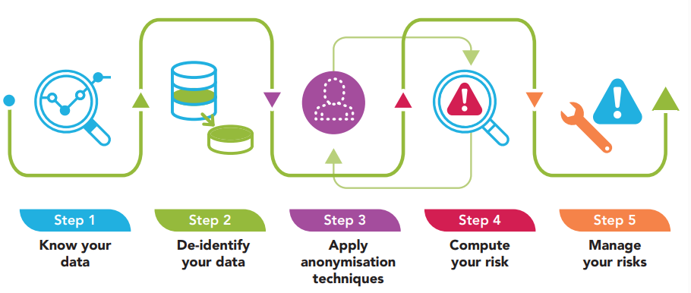
Data Anonymisation Process
guide-to-basic-anonymisation-(updated-24-july-2024).pdf

Slide 12
Step 1 – Know Your Data
guide-to-basic-anonymisation-(updated-24-july-2024).pdf

Slide 13
Step 1 – Know Your Data
Think about your data before collecting
What data are you collecting, what is the context?
Prepare a data collection and anonymisation plan
Evaluate the trade-off between the information value of your research data and the privacy risks of your participants
Do not collect data that you won't need! (data minimisation)
Find, categorize and assess your identifiers
Evaluate risk of reidentification
Evaluate risk of data disclosure causing harm based on the information you collected

Slide 14

Direct Identifiers
Information that on their own can uniquely identify a person​
​
Name​
Full Address​
ID numbers: social security/ NHS/ driver’s licence/passport​
Phone number​
Email address​
Audio or visual data

Slide 15
Go to Wooclap.com
Code CMHN
Exercise 1
Type what you believe are indirect identifiers​
​
(Information that when combined can be linked to a person)​

Slide 16

Indirect Identifiers
Information that when combined with other data may lead to identification of a person​ - Can be linked with other datasets resources to identify a person​
​
Date of birth​
Postcode​
Job title / employment details​
Physical information: sex, age, weight, height, ethnicity​
Diagnosis (in rare conditions)​
Some imaging data or clinical notes​
GP practice …​

Slide 17
Go to Wooclap.com
Code CMHN
Exercise 2
Dr Brain collected data from participants that have a rare bone disease in the city of York.
The raw dataset includes:
Name,
Postcode
Sex
Age
Ethnicity
Diagnosis
Symptoms
X-ray results
She then processed the dataset by masking the names and removing the postcode (removed direct identifiers).
Dr Brain thinks the processed data is now anonymised.​
👉 Is Dr Brain correct?​ 🧩 Why or why not?​

Slide 18
Step 2 – De-Identify Your Data
guide-to-basic-anonymisation-(updated-24-july-2024).pdf

Slide 19
De-identification
Removing or masking direct identifiers (names, address, etc)​
Data subjects can be identifiable by referring to other information held separately or by combining indirect identifiers information
Data protection still applies
Anonymisation​
Data is processed in such way that individuals are not identifiable and cannot be re-identified by any means (risk of re-identification is negligible).
Treats both direct and indirect identifiers. ​
​

Slide 20
Go to Wooclap.com
Code CMHN
Exercise 3
Group discussion
Think of scenarios when only de-identification, but not full anonymization can be useful?
5 min
Notes:
Answer:

Slide 21

De-identification
Anonymisation
De-identification without full anonymisation can be useful when data utility must be preserved for research or analysis without compromising individual’s privacy.
Some examples:
Data sharing with collaborators: An ongoing project when a statistician needs access to data for analysis but is not allowed to access identifiable data.
Longitudinal studies when researchers still need to link individual data over time (e.g., disease progression, treatment outcomes).
Monitoring disease patterns: e.g., how genetic mutations can influence disease. Researchers can link individual data back to genomic data and medical history.
In some cases you might want to use pseudonymisation techniques instead…we will see this later

Slide 22
Go to Wooclap.com
Code CMHN
Exercise 4
A mental health researcher is preparing to share a dataset from a study on young adults with sleep disorders. Direct identifiers like names and email addresses have been removed.
The dataset includes:
Non-prescribed supplements (melatonin, essential oils)
Sleep environment details
PER3 (Period circadian regulator) Gene sequencing
Psychotherapy attendance
Age
Sex
Ethnicity
Mental health diagnosis (e.g., ADHD, Bipolar)
Work pattern
Prescribed medication
Can you spot elements from this dataset from which disclosure would potentially cause harm, stigma, or discrimination?
Notes:
non-prescribed supplements (e.g., melatonin, herbal remedies, vitamins) is not automatically considered special category data under regulations like the GDPR — but it can be, depending on how it is used or what it implies.

Slide 23
Special Category data
Types of personal data that is particularly sensitive
If disclosed or misused could potentially lead to harm, discrimination, or stigmatisation
Require a higher level of protection
Examples (according to GDPR):
Ethnicity
Sexual orientation
Political beliefs, religion
Income/Salary
Genetic data
Data concerning health
e.g.:
Use of medications
Medical diagnosis
Disability information
Medical visits...
But it also depends on data context…

Slide 24
Step 3 – Apply Anonymisation Techniques
guide-to-basic-anonymisation-(updated-24-july-2024).pdf

Slide 25
Before You Choose an Anonymisation Technique
Understand your data – Know which variables are direct, indirect, or sensitive to people like you (clinicians, researchers).
Balance privacy and utility – The more anonymous the data, the less useful it may become for research.
Plan ahead – Anonymisation should be considered early, not after data is collected.
Choose technique by variable type – Use the right method for each kind of data (e.g., generalise age, mask emails, suppress rare conditions).

Slide 26
Technique 1- Data Masking
Replace part or all of a data value with a placeholder (e.g., *, XXX).​
Applied on: Direct identifiers.​
Email | Sleep Time | Address
JohnDi@example.com | Between 10 pm to 6 am | Falt 1, Example street, EH12JA
MariMi@example.com | Between 12 am to 8 am | 8 Middle Building, EH165TU
Email | Sleep Time | Address
J*****@example.com | Between 10 pm to 6 am | EH1xxx
M****@example.com | Between 12 am to 8 am | EH16xxx

Slide 27
Technique 1- Data Masking
Retaining the structure or appearance of data without exposing its content, so that the data still "works" in your system, analysis, or demo — while protecting identity.
Pros:
Simple
Retains the structure
Cons:
Still reversible if not done carefully and perfectly
When to Use It - Example
When format is NHS a field must be exactly 10 characters (like an NHS number or ID), you can mask it as 12*****890 — this keeps the format working in your software or demo, without revealing the real value.eeded but not content;

Slide 28
Technique 2- Generalisation
Replace specific values with broader categories.
Applied on: indirect identifiers/Sensitive variables while keeping utility.
Sleep Duration
6.2
7
8.5
5.5
6.7
Sleep Duration
5-7 Hours
7-9 hours
7-9 hours
5-7 Hours
5-7 Hours

Slide 29
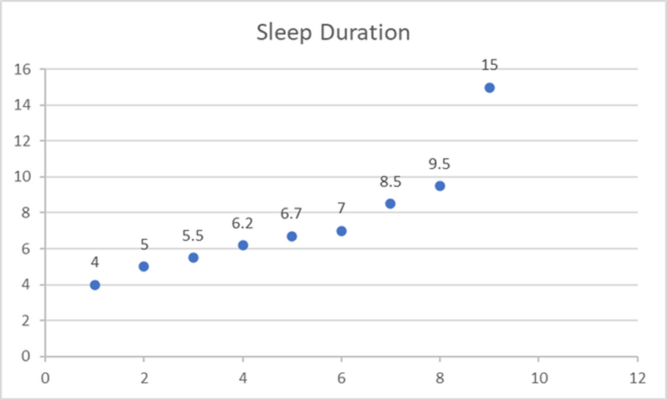
Technique 2- Generalisation
What If we Have identifiers?
Sleep Duration
6.2
7
8.5
5.5
6.7
15
9.5
4
5
Sleep Duration
5-7 Hours
7-9 hours
7-9 hours
5-7 Hours
5-7 Hours
above 9
above 9
less than 5
5-7 Hours

Slide 30
Technique 2- Generalisation
Generalisation in descriptive texts
Generalise the meaning of a detailed text
(e.g., patient’s clinical information; diagnosis; participant description of an event)
Original transcript
“My depressive symptoms got worse right after my brother David died in the London Marks & Spencer fire. It got worse around Christmas when I was alone in my flat in Camden. Dr Leslie Aubrey said I might have bipolar disorder type II, but I didn’t want to tell anyone, especially not my boss at LNER.”
“My depressive symptoms got worse right after the loss of a family member in a public accident. It got worse around Christmas when I was alone in my flat. My psychiatrist said I might have bipolar disorder, but I didn’t want to tell anyone, especially not my employer.”
Generalised 1
Generalised 2
“My depressive symptoms got worse right after a traumatic loss. It got worse around the holidays when I was alone in my home. My medical professional said I might have a mental health disorder, but I didn’t want to tell anyone, especially not my employer.”

Slide 31
Technique 2- Generalisation
When exact detail is too granular; grouping helps protect identity while retaining meaning
Pros:
Reduces re-ID risk
Cons:
Can reduce data granularity
Loss of analytical power
When to Use It - Example
Avoid over-generalising (e.g., 18–80 as one group); you’ll lose utility
Ensure each category has enough records to avoid re-identification
Choose cut-offs that make clinical or research sense (e.g., age groups)
Use open-ended ranges (e.g., 90+, ≤5) to reduce re-ID risk

Slide 32
Technique 3 - Suppression
Suppression means withholding or removing a data value that is too identifying to safely share — even after other anonymisation techniques are applied.
Applied on: Direct & Indirect Identifiers
Sleep Duration
5-7 Hours
7-9 hours
7-9 hours
5-7 Hours
5-7 Hours
above 9
above 9
less than 5
5-7 Hours
Sleep Duration
5-7 Hours
7-9 hours
7-9 hours
5-7 Hours
5-7 Hours
above 9
above 9
Suppressed
5-7 Hours

Slide 33
Technique 3 - Suppression
Suppression Could be to remove:
Full column (Variables)
Full Row (Observations)
Open-ended Question

Slide 34
Technique 3 - Suppression
Age | Diagnosis | Town | Sleep Duration (hrs) | Treatment
28 | Depression | Bristol | 7.2 | SSRI
33 | Bipolar Disorder | Village A | 9 | Lithium
45 | Anxiety | Manchester | 6.5 | CBT
27 | Rare Genetic | London | 5 | NA
60 | Depression | Edinburgh | 7.8 | Not taking medication

Slide 35


Technique 3 - Suppression
Age | Diagnosis | Town | Sleep Duration (hrs) | Treatment
28 | Depression | Bristol | 7.2 | SSRI
33 | Bipolar Disorder | Village A | 9 | Lithium
45 | Anxiety | Manchester | 6.5 | CBT
27 | Rare Genetic | London | 5 | NA
60 | Depression | Edinburgh | 7.8 | Not taking medication

Slide 36
Technique 3 - Suppression
When data is too unique or risky; not useful even in generalised form
Pros:
Deal with rare and unique variables
Cons:
Suppression is data loss
Loss of analytical power
When to Use It - Example
The data point is highly unique or rare - Even one detail may reveal identity (e.g., only person with X disorder)
The value is not essential for your research questions (better to lose a detail than compromise privacy)
Document any suppressed values.

Slide 37
Technique 4 - Aggregation
Aggregation is the process of combining individual-level data into summary statistics (like means, counts, medians) to reduce the risk of re-identification.
•Applied on: Indirect Identifiers
Patient | Diagnosis | Sleep (hrs)
PO1 | Depression | 6.2
PO2 | Bipolar Disorder | 7.8
PO3 | Anxiety | 8.1
PO4 | Bipolar Disorder | 6.5
PO5 | Depression | 6.9
PO6 | Anxiety | 5.9
PO7 | Anxiety | 7
Total Patients | Diagnosis | Sleep (hrs)
2 | Depression | 6.35
2 | Bipolar Disorder | 7.95
3 | Anxiety | 7
Statistical Disclosure Control on Aggregated Data

Slide 38
Technique 4 - Aggregation
Pros:
Strong privacy protection
Low computational effort
Cons:
Loss of individual variability
No use for advanced analysis
When to Use It - Example
You want to share trends, not individuals.
Useful for reports
Label clearly that data is aggregated
Small aggregates (e.g., 2 people) may still be identifying — watch group size!

Slide 39
Go to Wooclap.com
Code CMHN
Test Your Understanding
Go to Exercise 5
Match each scenario below with the most appropriate anonymisation technique:
(Masking, Generalisation, Suppression, Aggregation)

Slide 40
Other Anonymisation Techniques
Data Swapping (Shuffling): Switches attribute values between records to break the link between data and individuals.
Noise Addition: Adds random variation to numerical values to mask exact data while preserving overall patterns.
Synthetic Data Generation: Creates entirely artificial datasets that mimic the statistical properties of real data without revealing any true individuals.

Slide 41
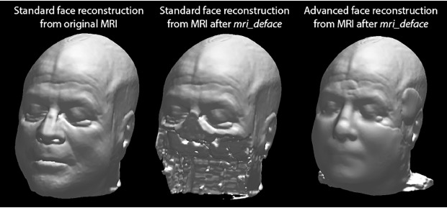
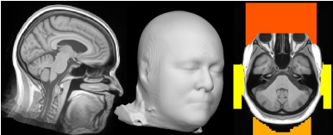
Techniques For Other Data Type
Images (e.g., MRI scans, face photos):
Blur or remove facial features; crop identifiable areas; apply pixelation or synthetic replacement.
Audio (e.g., interviews, voice recordings):
Voice masking, pitch alteration, or full transcription with redaction of names, locations, or identifiable accents.
Video (e.g., therapy sessions, clinical footage):
Face blurring, muting sensitive audio, body/gesture masking, or replacing with avatar-based reenactments.
Text (free-text notes or interviews):
Named Entity Recognition (NER) to detect and remove personal names, locations, and dates; manual or automated redaction.
Images from: https://www.sciencedirect.com/science/article/pii/S1053811921001221

Slide 42
Pseudonymisation
Pseudonymisation is a process where identifiers are replaced with fake or coded values — but the link to the original identity is kept (in a separate, secure file).
It reduces the risk of exposure while still allowing the data to be linked back if necessary (e.g. in clinical follow-ups or longitudinal research).
Name | NHS ID
Green | 290997248
Blue | 150592345
Yellow | 141275457
Name | NHS ID
PO24 | X2F7B91
PO56 | BB33UU5
PO66 | YY99YY99
A key file exists that maps po24 back to Green — stored securely and separately.

Slide 43
Pseudonymisation
Pros:
Protects identity in daily use
Enables follow-up or updates
Recognised under GDPR as a safeguard
Cons:
Still legally personal data
Risk if key is leaked
Extra step to fully anonymise
When to Use It - Example
You need to re-contact participants
You're managing sensitive personal data - Adds a layer of protection while preserving linkability
The data is processed internally (not fully public) - Previous planing on which researchers has access to the raw data
You want to link across multiple datasets

Slide 44
Pseudonymisation
 | Pseudonymisation | Anonymisation
Identity can be recovered | ✅ Yes (with a key) | ❌ No
GDPR considers it personal data? | ✅ Yes | ❌ No
Useful for follow-ups? | ✅ Yes (relinking possible) | ❌ No (no identifiers remain)
Risk if re-identified? | 🔺 Medium or High (depends on key security & other variables) | 🔻 Low (should be impossible to reverse)
Differentiate between Pseudoanymisation VS De-Identification

Slide 45


Options for pseudonymisation
Encryption: Reversible encoding of values
Encryption
Bob
X97FEFLb…
Jane
io2AhNy…
Decryption
Judy
+pxd0rN…
Hashing: Irreversible encoding of values
Bob
cd9fb1e1…
Hashing
Jane
4f2379…
Salt = 1234
(optional)
Judy
037c6b5…

Slide 46
Options for pseudonymisation
Retrieving data from hashed tables
Hashing
cd9fb1e1…
Bob
cd9fb1e1…
Salt = 1234
4f2379…
037c6b5…
Requires both the target value (“Bob”) and the salt
Does not give access to other table rows
Does not give access to other hashed values in the table

Slide 47
Hashing is not always enough...
2013: a New-York City taxi company publishes a dataset with 173 million taxi trips
License plate number and taxi ID are hashed:
6B111958A39B24140C973B262EA9FEA5, D3B035A03C8A34DA17488129DA581EE7,VTS,5,,2013-12-03 15:46:00,2013-12-03 16:47:00,1,3660,22.71,-73.813927,40.698135,-74.093307,40.829346
However, taxi licence plates have exactly 6 digits, which means there are only ~3M possibilities
-> A computer can quickly run through the possibilities and re-identify the table
Avoid using (only) hashing for data that has a fixed format (e.g. date of birth)

Slide 48

Tools examples
Pseudonymisation
Find examples of Hashing in R, Python and Excel on the course's github repository:
https://github.com/BioRDM/data-anonymisation-workshop
Anonymisation software
https://arx.deidentifier.org/
sdcMicro
https://github.com/sdcTools/sdcMicro/
Keep your data safe, beware of online tools (and LLMs)!!

Slide 49
Step 4 – Compute Your Risk
guide-to-basic-anonymisation-(updated-24-july-2024).pdf

Slide 50
k-anonymity
Name | Age | Sex | Medication
Rachel | 30 | Female | None
Alice | 29 | Female | Sertraline
Bob | 34 | Male | Escitalopram
Judy | 24 | Female | None
Charlie | 31 | Male | Sertraline
David | 28 | Male | Escitalopram
Richard | 28 | Male | None
Robert | 39 | Male | None
Eve | 35 | Female | Escitalopram
Jade | 22 | Female | Sertraline
Sarah | 38 | Female | None
John | 35 | Male | None

Slide 51
k-anonymity
Name | Age | Sex | Medication
Rachel | 30 | Female | None
Alice | 29 | Female | Sertraline
Bob | 34 | Male | Escitalopram
Judy | 24 | Female | None
Charlie | 31 | Male | Sertraline
David | 28 | Male | Escitalopram
Richard | 28 | Male | None
Robert | 39 | Male | None
Eve | 35 | Female | Escitalopram
Jade | 22 | Female | Sertraline
Sarah | 38 | Female | None
John | 35 | Male | None
Name | Age | Sex | Medication
* | 20-40 | Female | None
* | 20-40 | Female | Sertraline
* | 20-40 | Male | Escitalopram
* | 20-40 | Female | None
* | 20-40 | Male | Sertraline
* | 20-40 | Male | Escitalopram
* | 20-40 | Male | None
* | 20-40 | Male | None
* | 20-40 | Female | Escitalopram
* | 20-40 | Female | Sertraline
* | 20-40 | Female | None
* | 20-40 | Male | None
Is this dataset fully anonymised?

Slide 52
k-anonymity
Name | Age | Sex | Medication
* | 20-40 | Female | None
* | 20-40 | Female | Sertraline
* | 20-40 | Male | Escitalopram
* | 20-40 | Female | None
* | 20-40 | Male | Sertraline
* | 20-40 | Male | Escitalopram
* | 20-40 | Male | None
* | 20-40 | Male | None
* | 20-40 | Female | Escitalopram
* | 20-40 | Female | Sertraline
* | 20-40 | Female | None
* | 20-40 | Male | None
There is:
Only 1 female on Escitalopram
Only 1 male on Sertraline
...
-> increased risk of re-identification
k-anonymity ensures that every record is indistinguishable from (k-1) other records​

Slide 53
k-anonymity
Name | Age | Sex | Medication
* | 20-40 | * | None
* | 20-40 | * | Sertraline
* | 20-40 | * | Escitalopram
* | 20-40 | * | None
* | 20-40 | * | Sertraline
* | 20-40 | * | Escitalopram
* | 20-40 | * | None
* | 20-40 | * | None
* | 20-40 | * | Escitalopram
* | 20-40 | * | Sertraline
* | 20-40 | * | None
* | 20-40 | * | None
Solution 1: remove Sex information
Every subject has at least 2 other identical entries
k = 3 is satisfied

Slide 54
k-anonymity
Name | Age | Sex | On Antidepressants
* | 20-40 | Female | No
* | 20-40 | Female | Yes
* | 20-40 | Male | Yes
* | 20-40 | Female | No
* | 20-40 | Male | Yes
* | 20-40 | Male | Yes
* | 20-40 | Male | No
* | 20-40 | Male | No
* | 20-40 | Female | Yes
* | 20-40 | Female | Yes
* | 20-40 | Female | No
* | 20-40 | Male | No
Solution 2: generalise Medication information
Every subject has at least two other identical entries
k = 3 is satisfied

Slide 55
k-anonymity: how to choose k?
Typical value range: 3 – 20 (NHS recommends minimum 3-5)
Increase k depending on:
Re-identification risk
Large datasets
Number of quasi-identifying variables
Availability of external data that could be crossed
Sensitivity of the data
Use higher k to protect sensitive data better
Utility of the data
Balance re-identification risk with data utility
Start high, then reduce to a reasonable utility/anonymity balance

Slide 56
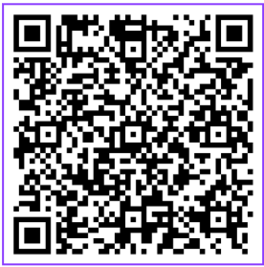
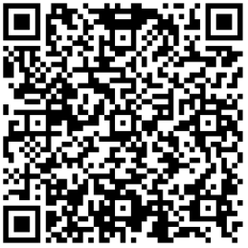
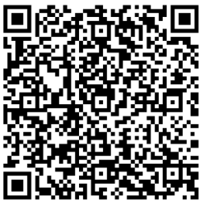
Group Exercise
Group 1
Interview example – Qualitative Data
Group 2
Sleep Data – Quantitative Data
Group 3
Biological and Lab Data – Quantitative Data

Slide 57
Final considerations
Know your data: understand the context, evaluate risks
Plan– prepare a data collection and anonymisation plan
Identify, describe, plan anonymisation techniques
Include data management plan!

Slide 58
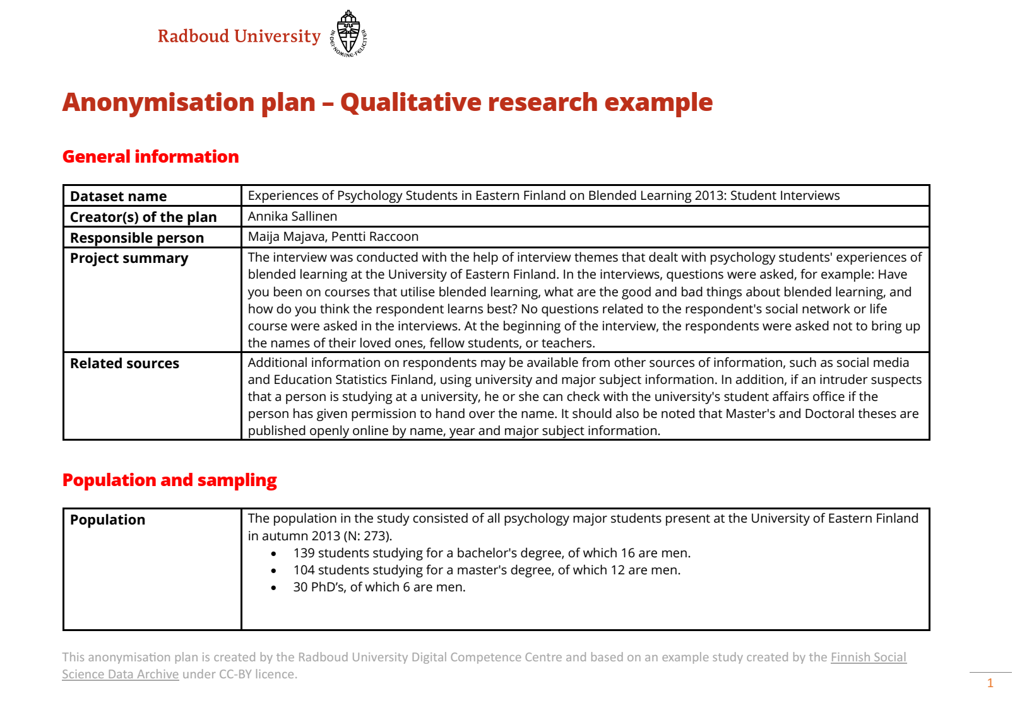
https://doi.org/10.5281/zenodo.10782781

Slide 59
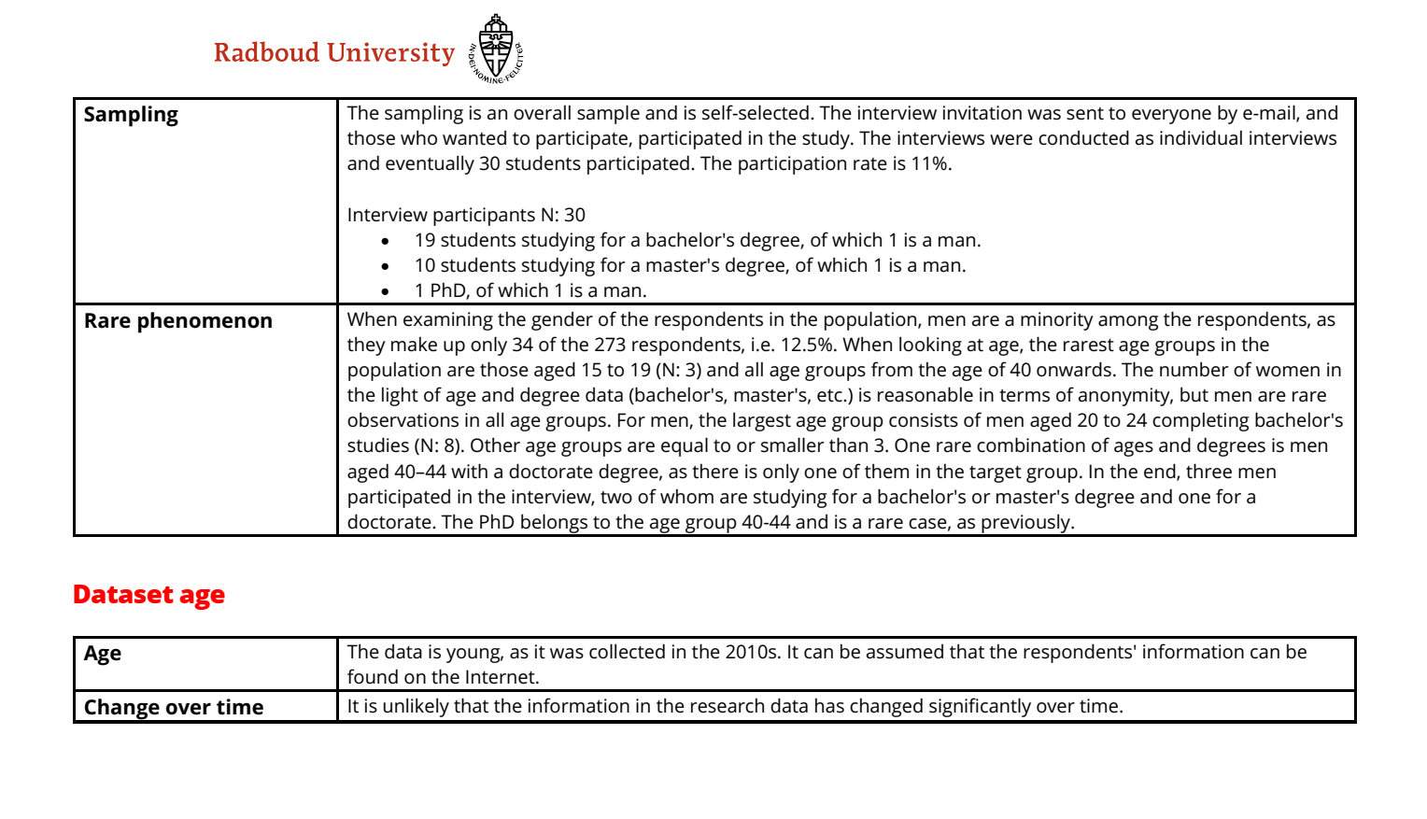
https://doi.org/10.5281/zenodo.10782781

Slide 60
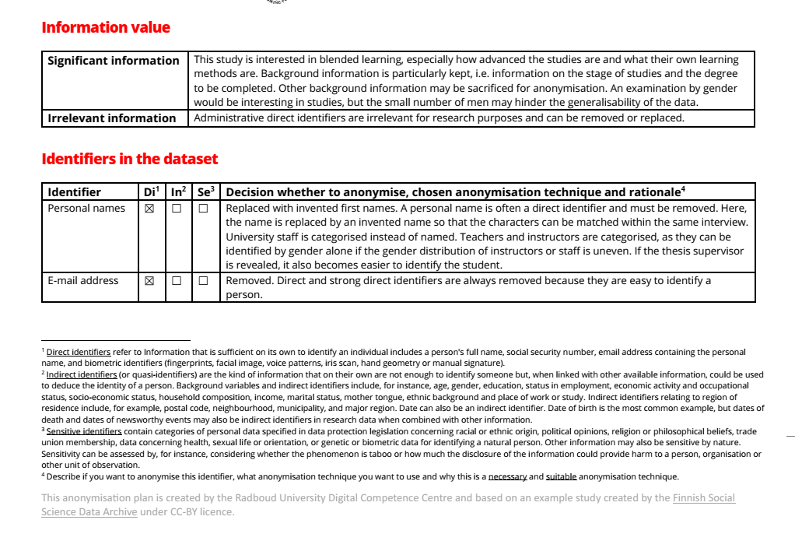
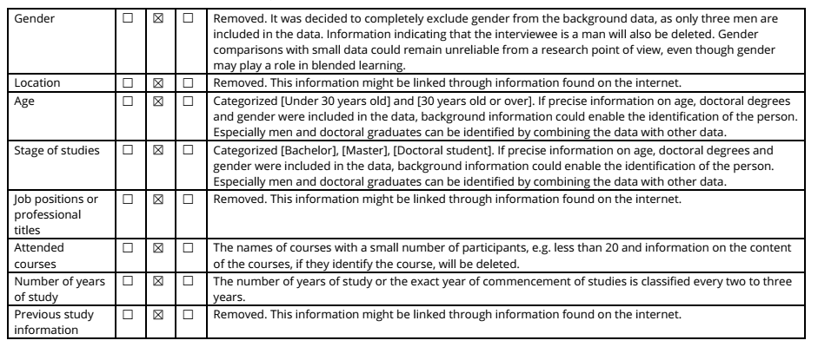
https://doi.org/10.5281/zenodo.10782781

Slide 61
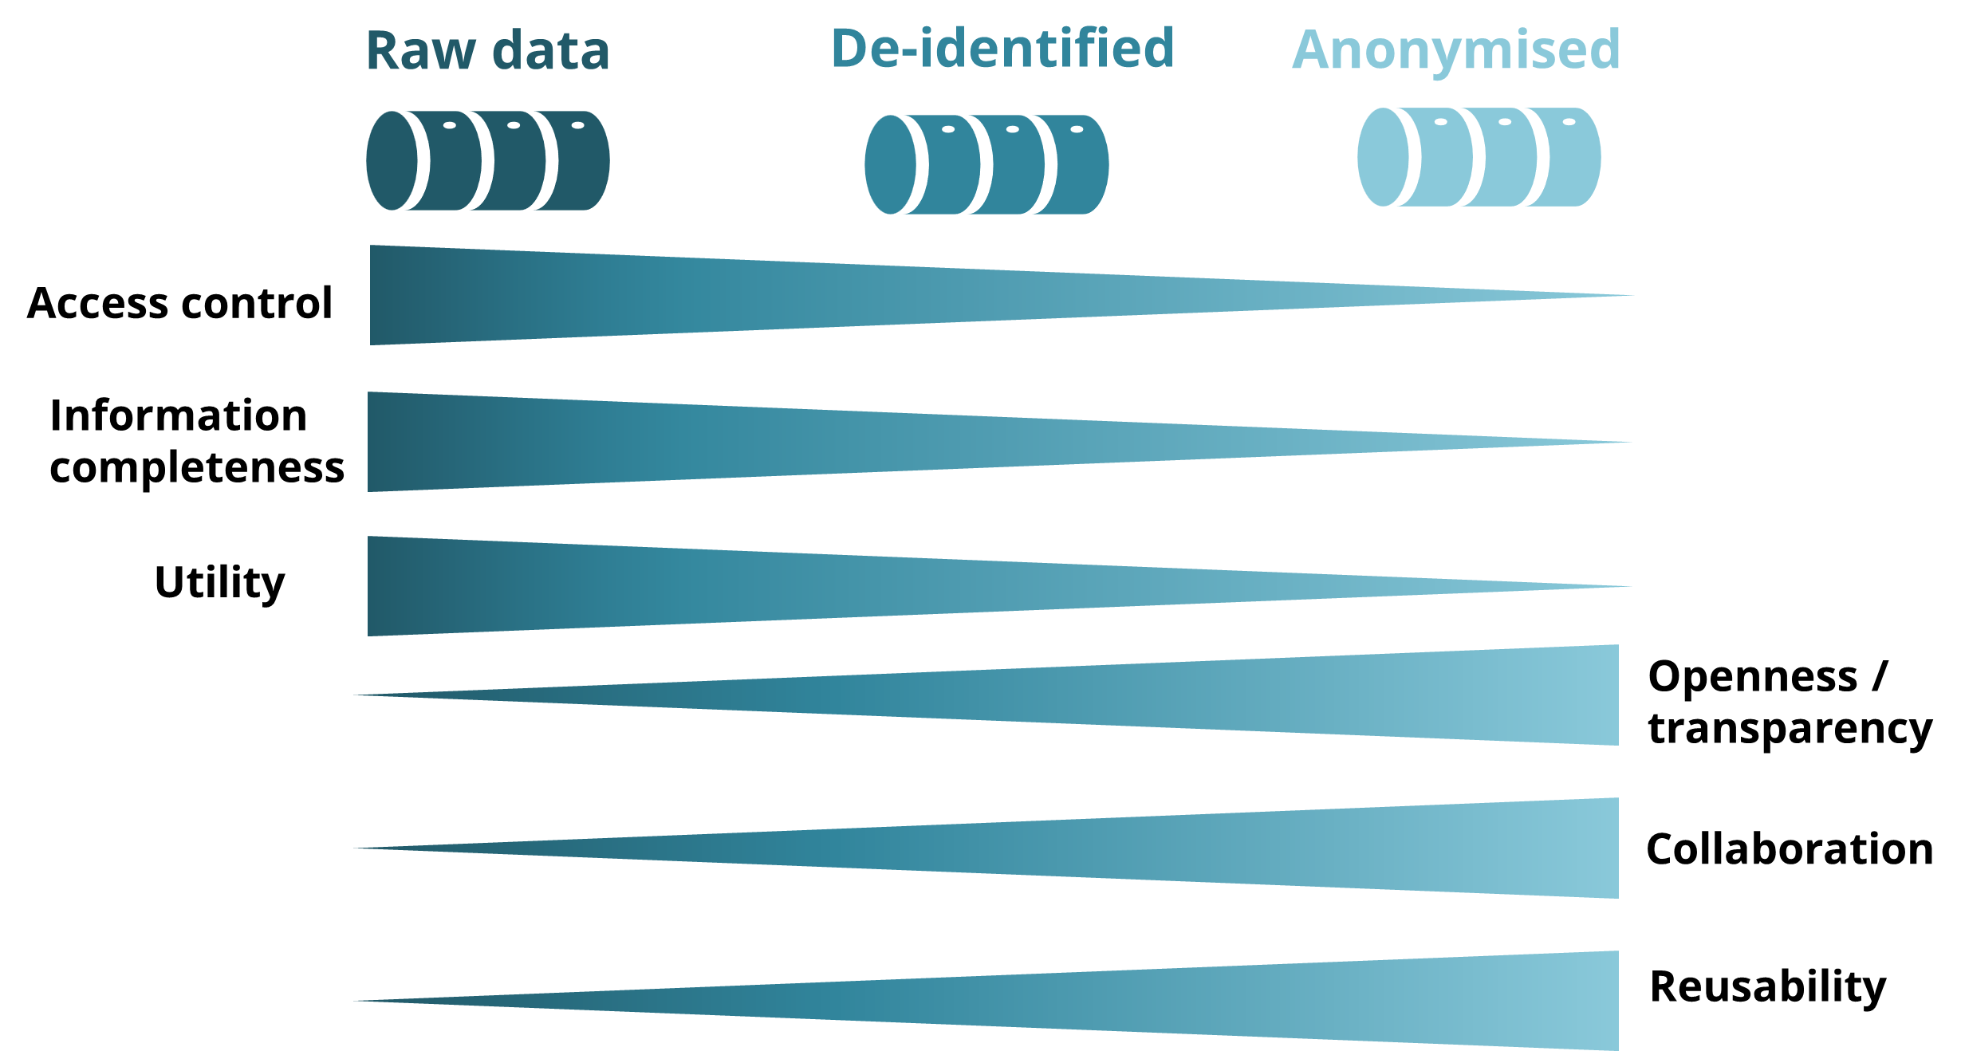
Final considerations
Understand your trade-offs when anonymising: information value of your research data, privacy risks of your participants, benefits of data anonymisation and sharing
If needed, consider controlled access (e.g., when retaining utility of the data or when full anonymisation is not possible)
Re-assess re-identification risks

Slide 62
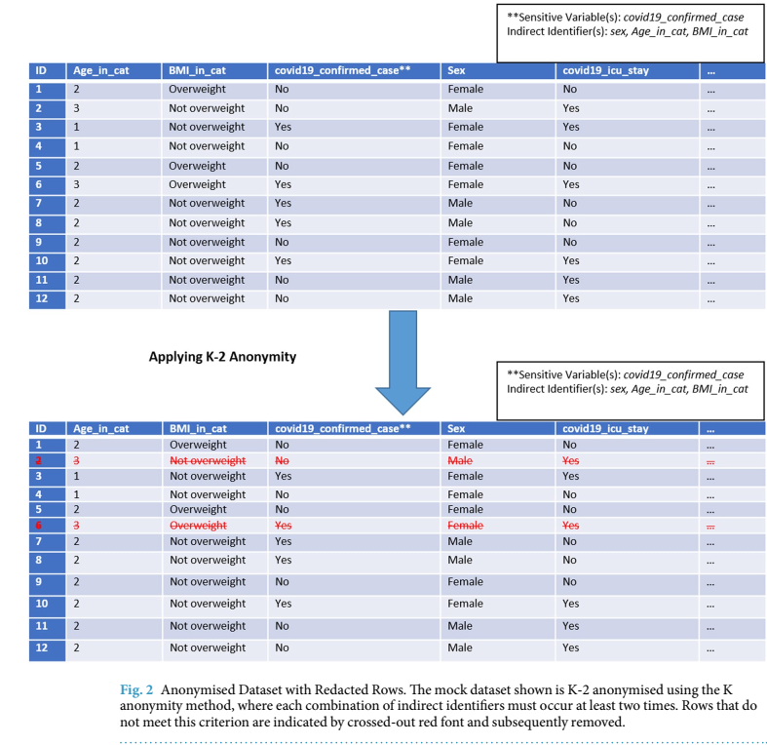
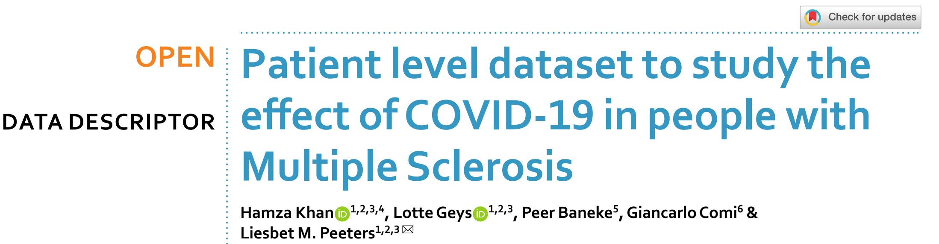
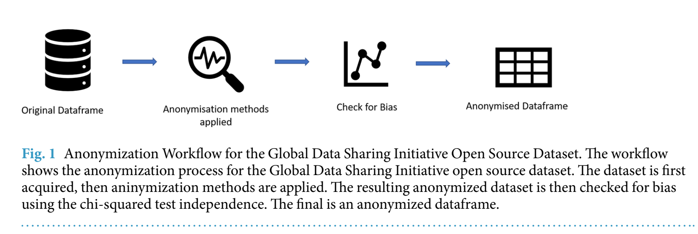
Data sharing examples
Sci Data 11, 149 (2024). https://doi.org/10.1038/s41597-024-02978-x

Slide 63
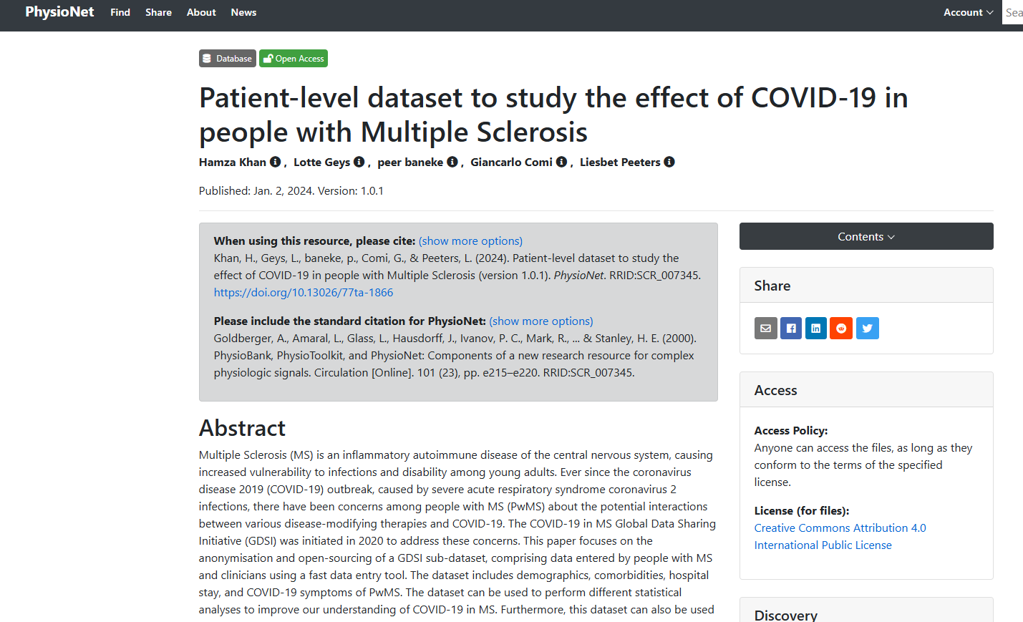
Data sharing examples
https://physionet.org/content/patient-level-data-covid-ms/1.0.1/
https://www.nature.com/articles/s41597-024-02978-x
Notes:
PhysioNet is a public research resource that provides free access to large-scale physiological and clinical data,

Slide 64

Data sharing examples
Biobank of data from 10,000 New York area participants (ages 5–21)
“find biological markers that will improve the diagnosis and treatment of mental health and learning disorders”
Open imaging data (MRI/EEG) are fully anonymized by removing any potential protected health information identifiers, including identifying facial features from anatomical images, and randomizing the timing of release.
Some data are protected by a Data Usage Agreement (DUA), but no protected health identifiers are present.
(De-identified data with safeguarded access!)
Anonymised data used for several data Science Competitions using the HBN dataset
Global Challenge: Relating Physical Activity to Problematic Internet Use. CMI, Kaggle.
(demographic, psychological assessments, internet use patterns)
Notes:
The goal of this competition is to develop a predictive model that analyzes children's physical activity and fitness data to identify early signs of problematic internet use. Identifying these patterns can help trigger interventions to encourage healthier digital habits.

Slide 65

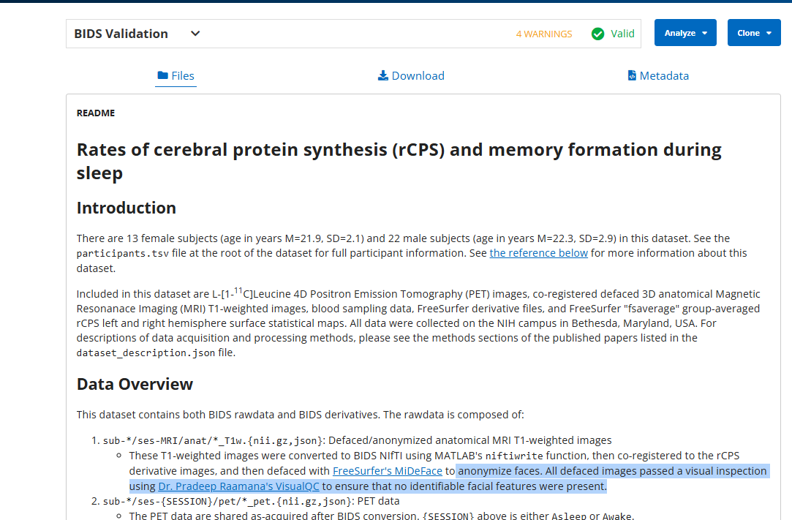
Data sharing examples
https://openneuro.org/datasets/ds004466/versions/1.0.3
Notes:
Platform free open neuroimaging data

Slide 66
Learning resources
UK Data Service- How to anonymise qualitative and quantitative data
https://ukdataservice.ac.uk/learning-hub/research-data-management/#anonymisation
UK Data Service- Data Management / Anonymisation
https://ukdataservice.ac.uk/app/uploads/2021_04_16_ukds_anonymisationv2.pdf
ICO - How do we ensure anonymisation is effective?
https://ico.org.uk/media2/migrated/4018606/chapter-2-anonymisation-draft.pdf
Singapore University- Guide to basic anonymisation
https://researchguides.smu.edu.sg/ld.php?content_id=51316292
https://www.pdpc.gov.sg/-/media/files/pdpc/pdf-files/advisory-guidelines/guide-to-basic-anonymisation-(updated-24-july-2024).pdf
Radboud University: Anonymisation plan template
https://doi.org/10.5281/zenodo.10782781

Slide 67
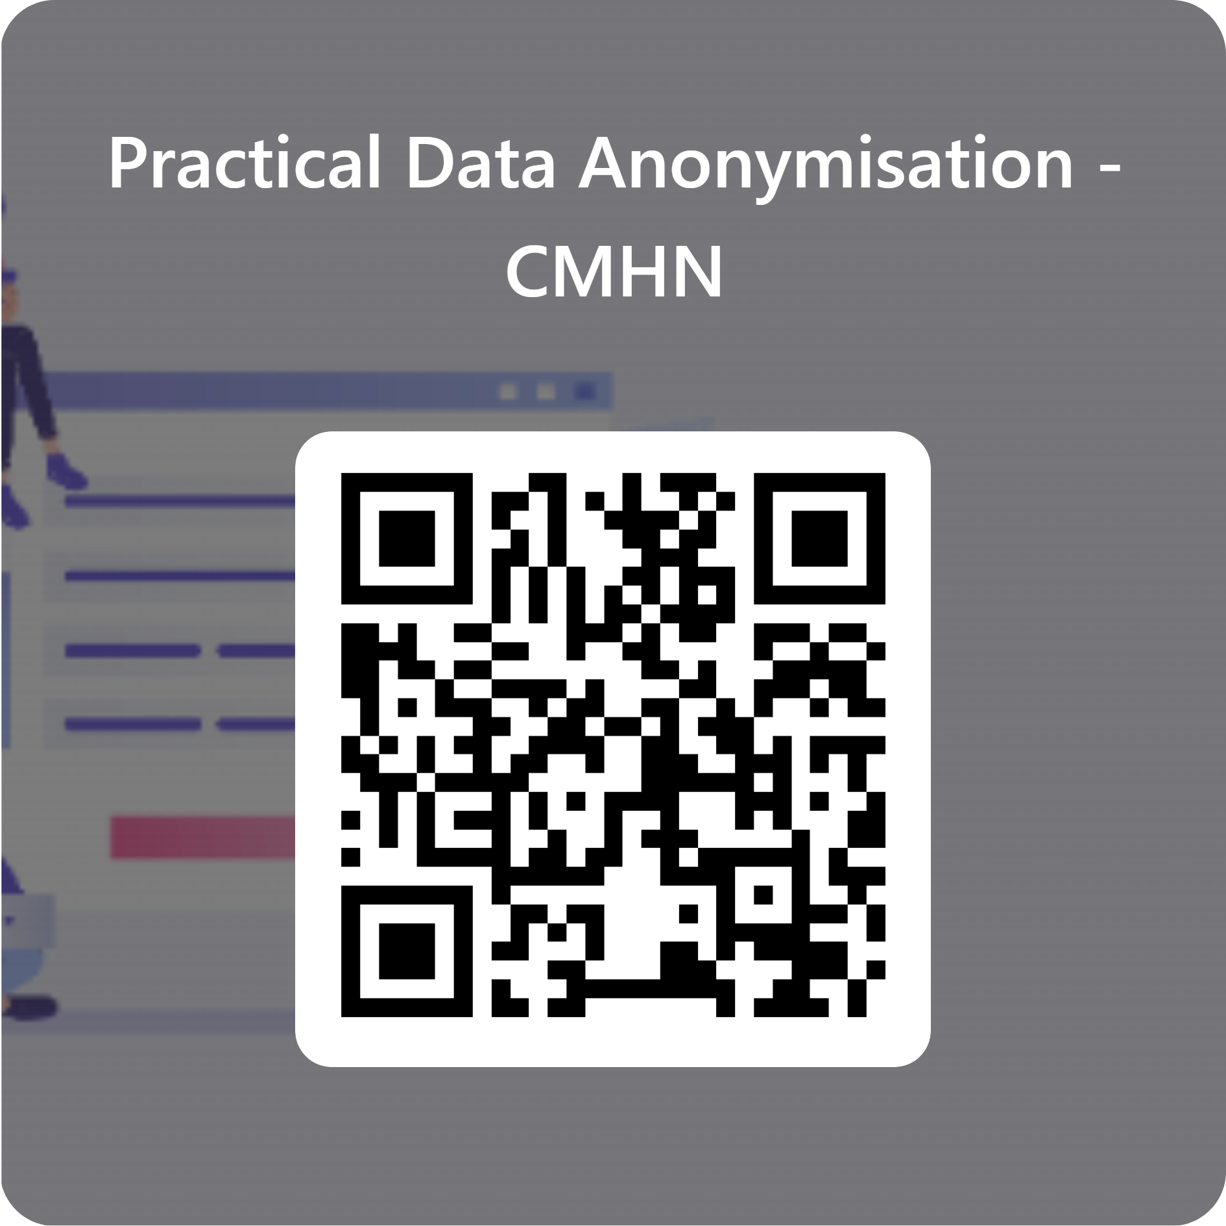
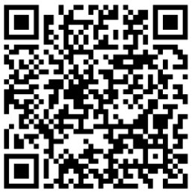
Thank you / Questions?
The materials from this course can be found in our GitHub repository
Please provide us feedback :)
https://github.com/BioRDM/data-anonymisation-workshop/
https://forms.office.com/e/UQEr3VCESs

